Slide 1
Local Search

Slide 2

Local Search
Solve problems approximately
—— aims at a local optimum
Neighborhood
Global Minimum
Guess
Can the algorithm terminate
in a finite number of steps?
Until no improvement is possible

Slide 3
Local Search
Framework of Local Search
☞ Local
Define neighborhoods in the feasible set
A local optimum is a best solution in a neighborhood
☞ Search
Start with a feasible solution and search a better one within the neighborhood
A local optimum is achieved if no improvement is possible

Slide 4
Local Search
Neighbor Relation
☞ S ∼ S' : S' is a neighboring solution of S – S' can be obtained by a small modification of S.
☞ N(S): neighborhood of S – the set { S': S ∼ S' }.
SolutionType Gradient_descent()
{ Start from a feasible solution S ∈ FS ;
MinCost = cost(S);
while (1) {
S’ = Search( N(S) ); /* find the best S’ in N(S) */
CurrentCost = cost(S’);
if ( CurrentCost < MinCost ) {
MinCost = CurrentCost; S = S’;
}
else break;
}
return S;
}
Notes:
注： gradient descent —— 梯度下降法。前面找碗底最低点就是这个方法，因为下降方向是数学中的“梯度”，所以得名。

Slide 5
Local Search
〖Example〗 The Vertex Cover Problem.
❖ Vertex cover problem: Given an undirected graph G = (V, E) and an integer K, does G contain a subset V' ⊆ V such that |V'| is (at most) K and every edge in G has a vertex in V' (vertex cover)?
❖ Vertex cover problem: Given an undirected graph G = (V, E). Find a minimum subset S of V such that for each edge (u, v) in E, either u or v is in S.
☞ Feasible solution set FS : all the vertex covers. V ∈ FS
☞ cost(S) = | S |
☞ S ∼ S': S' can be obtained from S by (adding or)
deleting a single node.
Each vertex cover S has at most |V| neighbors.
☞ Search: Start from S = V; delete a node and check if S' is a vertex cover with a smaller cost.

Slide 6
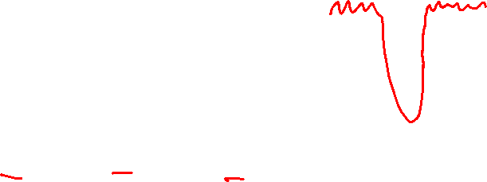

Local Search
Case 0:
S = ∅
✓
✗
Case 1:
Case 2:
…………
Discussion 17:
Can you give another case in which gradient descent doesn’t work?

Slide 7
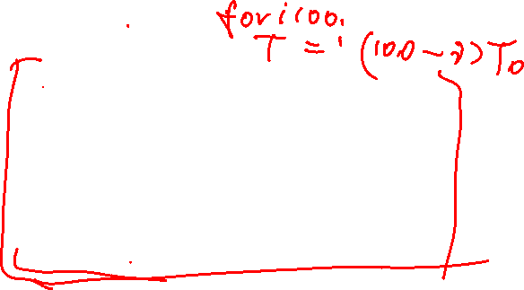

Local Search
Try to improve …
☞ The Metropolis Algorithm
SolutionType Metropolis()
{ Define constants k and T;
Start from a feasible solution S ∈ FS ;
MinCost = cost(S);
while (1) {
S’ = Randomly chosen from N(S);
CurrentCost = cost(S’);
if ( CurrentCost < MinCost ) {
MinCost = CurrentCost; S = S’;
}
else {
With a probability , let S = S’;
else break;
}
}
return S;
}
Adding is allowed
Notes:
注：对于case 1，有一定概率可以跳出local optimum得到正确解。但是对case 0，有可能在加1和减1之间无限震荡……
注：当（温度）T很高时，上坡的概率几乎为1，容易引起底部震荡；当T接近0时，上坡概率几乎为0，接近原始的梯度下降法。

Slide 8
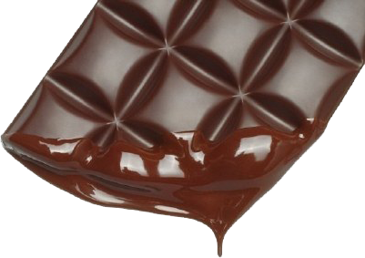
Local Search
☞ Simulated Annealing
The material is cooled very gradually from a high temperature, allowing it enough time to reach equilibrium at a succession of intermediate lower temperatures.
Cooling schedule: T = { T₁ , T₂ , … }

Slide 9
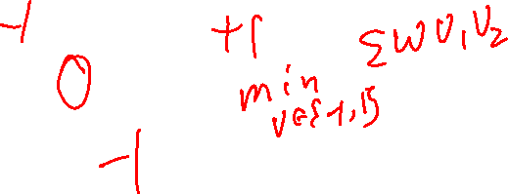
Local Search
〖Example〗 Hopfield Neural Networks
Graph G = (V, E) with integer edge weights w (positive or negative).
If w_{e} < 0, where e = (u, v), then u and v want to have the same state;
if w_{e} > 0 then u and v want different states.
± 1
The absolute value |w_{e}| indicates the strength of this requirement.
Output: A configuration S of the network –
an assignment of the state s_{u} to each node u
There may be no configuration that respects the requirements imposed by all the edges.
7
☞ Find a configuration that is sufficiently good.
5
6

Slide 10
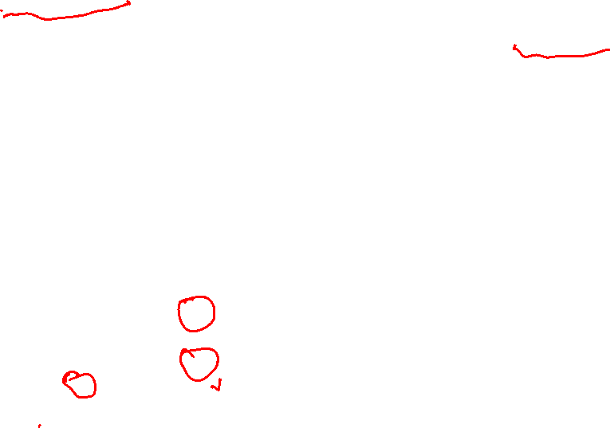
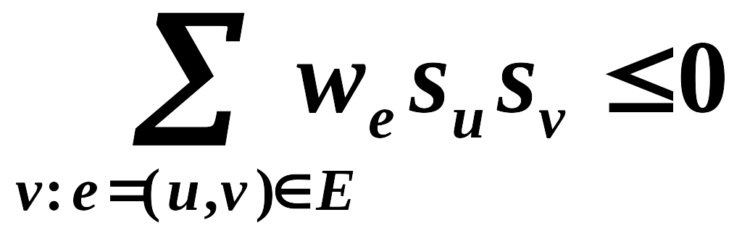
Local Search
〖Definition〗 In a configuration S, edge e = (u, v) is good if w_{e} s_{u} s_{v} < 0 (w_{e} < 0 iff s_{u} = s_{v} ); otherwise, it is bad.
〖Definition〗 In a configuration S, a node u is satisfied if the weight of incident good edges ≥ weight of incident bad edges.
〖Definition〗A configuration is stable if all nodes are satisfied.
Does a Hopfield network always have a stable configuration, and if so, how can we find one?
4
-1
-4-1-1+5
✓
-10
-5
-1
-10+5

Slide 11

Local Search
☞ State-flipping Algorithm
ConfigType State_flipping()
{
Start from an arbitrary configuration S;
while ( ! IsStable(S) ) {
u = GetUnsatisfied(S);
s_{u} = - s_{u};
}
return S;
}
8
-1
Will it always terminate?
-10
-5
-1

Slide 12

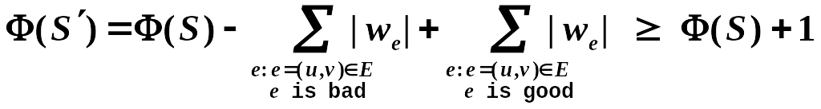
Local Search
Claim: The state-flipping algorithm terminates at a stable configuration after at most W = Σ_{e}|w_{e}| iterations.
Proof:
Consider the measure of progress
Φ(S) = Σ_{e is good} |w_{e}|
  When u flips state (S becomes S’):
  all good edges incident to u become bad
  all bad edges incident to u become good
  all other edges remain the same
Clearly 0 ≤ Φ(S) ≤ W

Slide 13
Local Search
Related to Local Search
☞ Problem: To maximize Φ.
☞ Feasible solution set FS : configurations
☞ S ∼ S': S' can be obtained from S by flipping a
single state
Claim: Any local maximum in the state-flipping algorithm to maximize Φ is a stable configuration.
Is it a polynomial time algorithm?
Still an open question: to find an algorithm that constructs stable states in time polynomial in n and logW (rather than n and W), or in a number of primitive arithmetic operations that is polynomial in n alone, independent of the value of W.

Slide 14
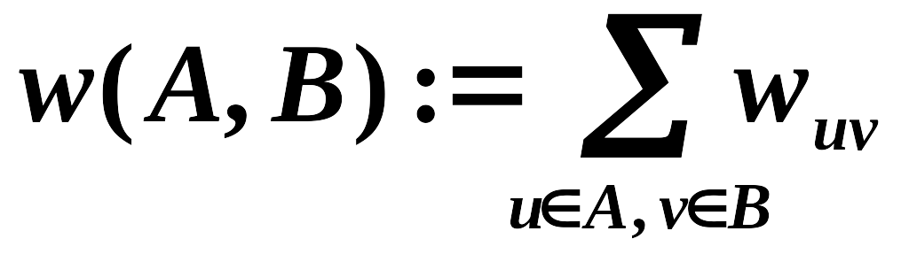
Local Search
〖Example〗 The Maximum Cut Problem.
❖ Maximum Cut problem: Given an undirected graph G = (V, E) with positive integer edge weights w_{e}, find a node partition (A, B) such that the total weight of edges crossing the cut is maximized.
Toy application
  n activities, m people.
  Each person wants to participate in two of the activities.
  Schedule each activity in the morning or afternoon to maximize number of people that can enjoy both activities.
Real applications Circuit layout, statistical physics

Slide 15
Local Search
Related to Local Search
Single-flip neighborhood
☞ Problem: To maximize w(A, B).
Φ(S) = Σ_{e is good} |w_{e}|
☞ Feasible solution set FS : any partition (A, B)
☞ S ∼ S': S' can be obtained from S by moving one
node from A to B, or one from B to A.
 A special case of Hopfield Neural Network – with w_{e} all being positive!
ConfigType State_flipping()
{
Start from an arbitrary configuration S;
while ( ! IsStable(S) ) {
u = GetUnsatisfied(S);
s_{u} = - s_{u};
}
return S;
}
May NOT in polynomial time
How good is this local optimum?
Try a better local?

Slide 16
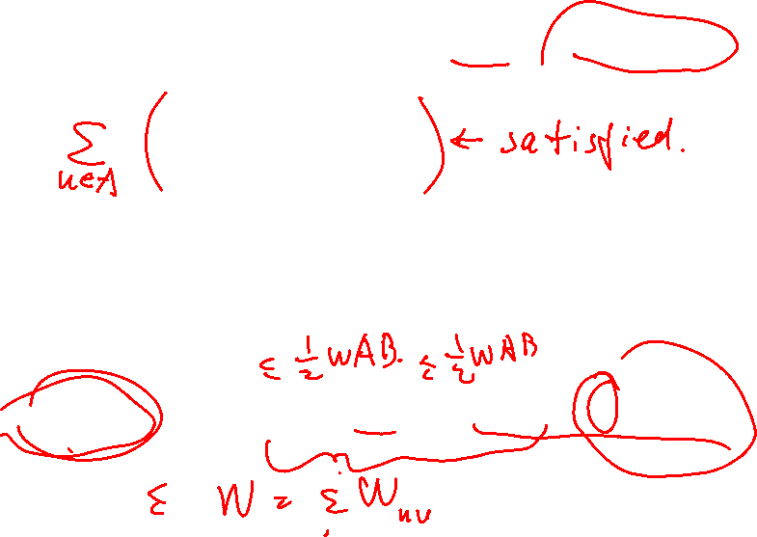
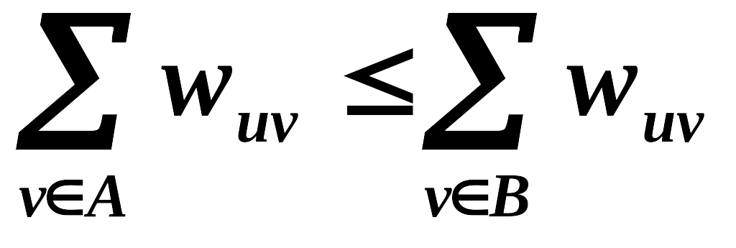
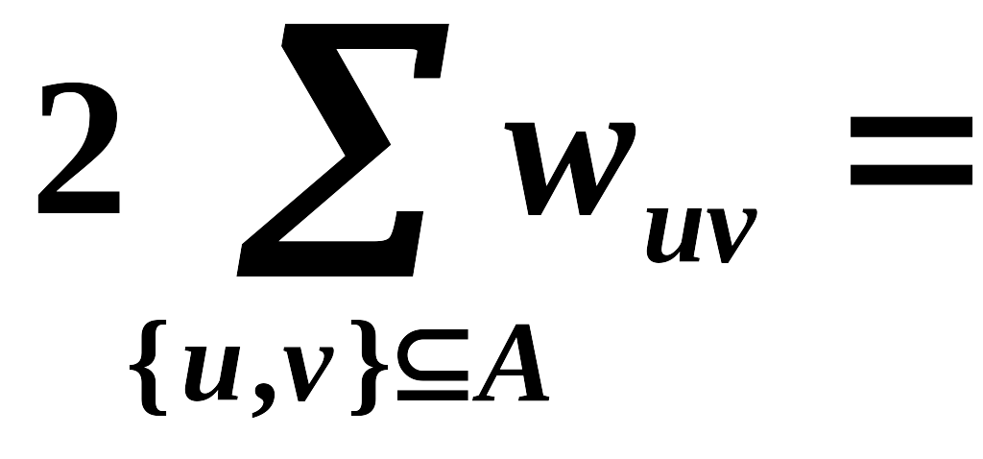
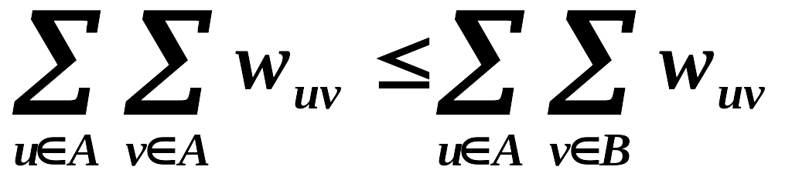
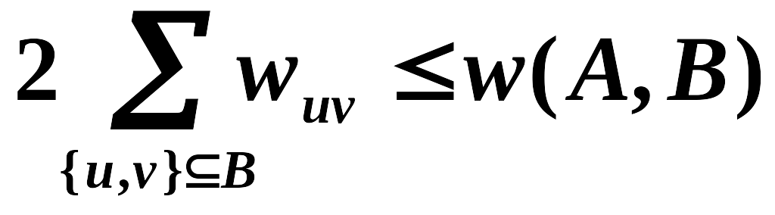
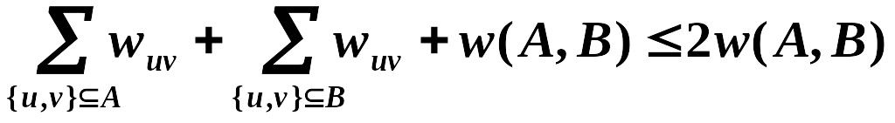
Local Search
How good is this local optimum?
Claim: Let (A, B) be a local optimal partition and let (A*, B*) be a global optimal partition. Then w(A, B) ≥ ½ w(A*, B*).
Proof:
Since (A, B) is a local optimal partition, for any u∈A
Summing up for all u∈A
= w(A, B)
w(A*, B*) ≤

Slide 17
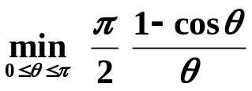
Local Search
[Sahni-Gonzales 1976] There exists a 2-approximation algorithm for MAX-CUT.
[Goemans-Williamson 1995] There exists a 1.1382-approximation algorithm for MAX-CUT.
[Håstad 1997] Unless P = NP, no 17/16 approximation algorithm for MAX-CUT.
1.0625

Slide 18
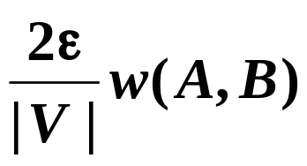
Local Search
May NOT in polynomial time
 stop the algorithm when there are no "big enough" improvements.
Big-improvement-flip: Only choose a node which, when flipped, increases the cut value by at least
Claim: Upon termination, the big-improvement-flip algorithm returns a cut (A, B) so that
(2 +ε) w(A, B) ≥ w(A*, B*)
Claim: The big-improvement-flip algorithm terminates after at most O(n/ ε log W) flips.
Notes:
根据时间简单描述证明：
每次flip至少增加(1+epsilon/n)倍，其实是（1+2*epsilon/n)倍
2. n/epsilon次flip之后，总增长至少是2倍。利用(1+1/x)^x >= 2, 如果x>=1
3. 总量不超过W，而cut翻倍的次数不能超过logW

Slide 19
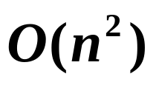
Local Search
Try a better local ?
The neighborhood of a solution should be rich enough that we do not tend to get stuck in bad local optima; but
the neighborhood of a solution should not be too large, since we want to be able to efficiently search the set of neighbors for possible local moves.
Single-flip k-flip
Θ(n^{k}) for searching in neighbors
[Kernighan-Lin 1970] K-L heuristic
Step 1: make 1-flip as good as we can – O(n)
(A₁, B₁) and v₁
Step k: make 1-flip of an unmarked node as good as we can – O(n-k+1)
(A_{k}, B_{k}) and v₁…v_{k}
Step n: (A_{n}, B_{n}) = (B, A)
Neighborhood of (A, B) = { (A₁, B₁), …, (A_{n-1}, B_{n-1}) }
Notes:
K-L的分析还是未解决的。

Slide 20
Reference:
Algorithm Design：Ch.12，p.661-706；Jon Kleinberg, Eva Tardos, Addison Wesley, 2005

